Slide 1
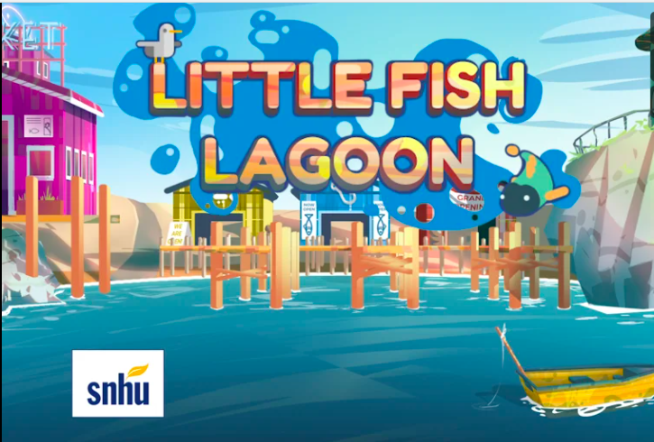

Slide 2
Introductions

Slide 3
AGENDA
Introductions
Background and Guiding Question
Quick Preview Video of the Game
Play Game!
Feedback Form

Slide 4
Guiding Questions
How do we win at Little Fish Lagoon?
How do we communicate effectively in teams?
What patterns of communication do you notice?
What are my strengths and weaknesses when working in groups?

Slide 5

TEAM
Notes:
Let’s take a moment to define what makes for an effective team.

Slide 6
In the Zoom Chat
What DO teams NEED when trying to communicate?

Slide 7
In the Zoom Chat
What DON’T teams WANT when trying to communicate?

Slide 8
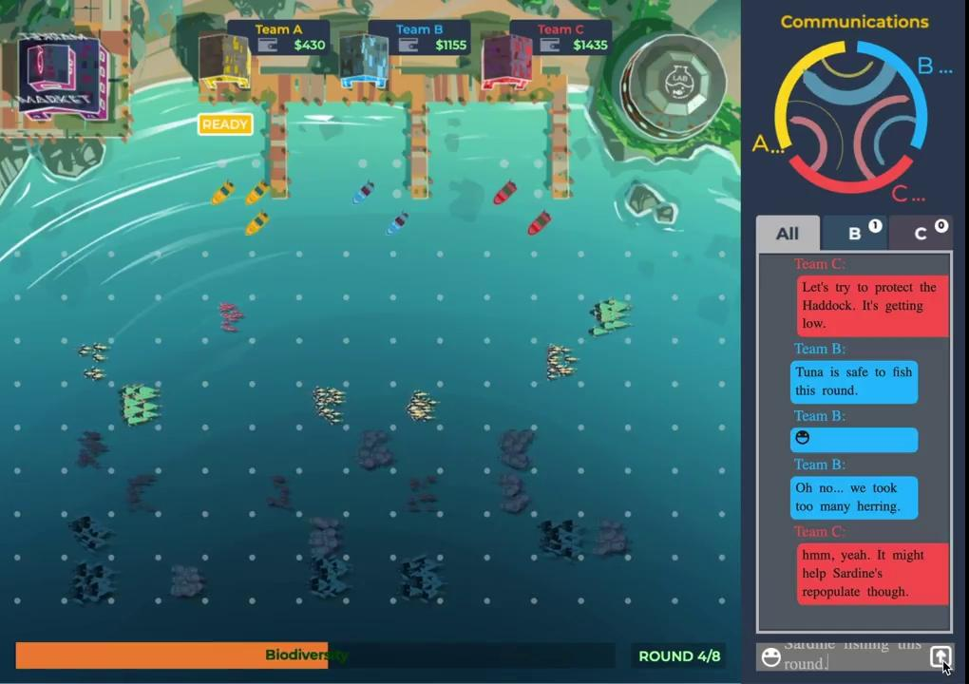
Notes:
Video Intro
https://vimeo.com/417368718

Slide 9


Slide 10

Instructions
Go through as many rounds as you can, catching fish and selling them.
Use the chat system to discuss strategy and type about your game decisions with other players
On Zoom, you may ask questions about the controls or how to play or if something isn’t working.

Slide 11

NORMS
Be kind
Be patient
Accept that the game is still being developed and is not perfect
If you have a question, ask !
Mistakes are welcome & necessary for growth
No one is perfect

Slide 12
Website: https://pisces-s3.s3.amazonaws.com/prod/index.html
Player Game Codes
 | 100701A | Yellow
 | 100701B | Blue
 | 100701C | Red
 | 100702A | Yellow
 | 100702B | Blue
 | 100702C | Red

Slide 13
Debrief
What was something you noticed about the game?

Slide 14
Collaboration
What was something you noticed about communication?

Slide 15
Feedback form:

Slide 16
THANK YOU!

